Slide 1
Chapter 4 Roundoff and Truncation Errors

Slide 2
Objectives
Knowing how to use the Taylor series for finite-difference approximation
Understanding how to write forward, backward, and centered finite-difference approximations of the first and second derivatives.
Understanding how roundoff errors occur because digital computers have a limited ability to represent numbers.
Learning how to quantify error.

Slide 3
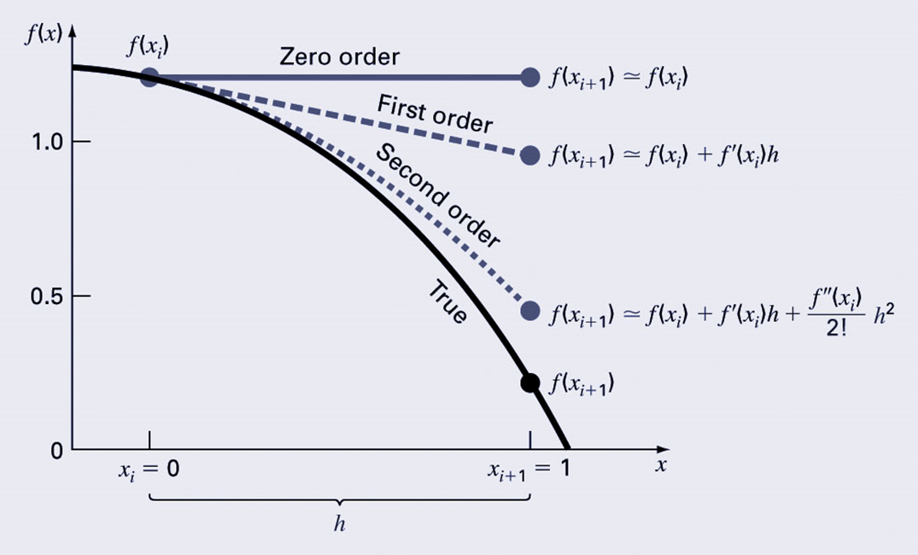
The Taylor Theorem and Series
The Taylor theorem states that any smooth function can be approximated as a polynomial.

Slide 4


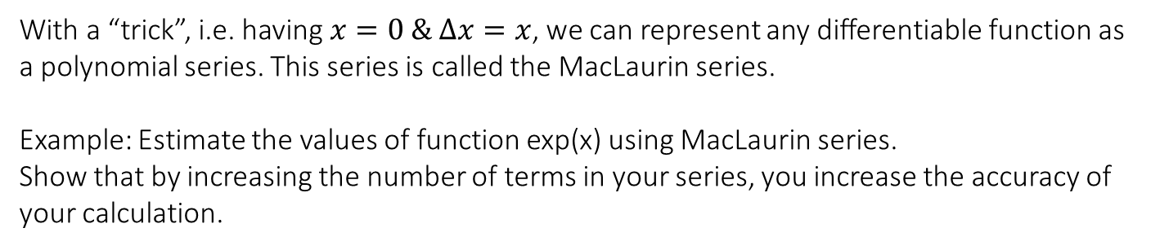
Taylor series
MacLaurin series, i.e. Taylor series at x_{i} = 0
With a “trick”, i.e. having $x=0 \& ∆x=x$, we can represent any differentiable function as a polynomial series. This series is called the MacLaurin series.
Example: Estimate the values of function exp(x) using MacLaurin series.
Show that by increasing the number of terms in your series, you increase the accuracy of your calculation.

Slide 5
Numerical Differentiation using Taylor series Finite difference (FD)
The first order Taylor series can be used to calculate approximations to derivatives:
Given:
Then:
This is termed a “forward” difference because it utilizes data at i and i+1 to estimate the derivative.

Slide 6
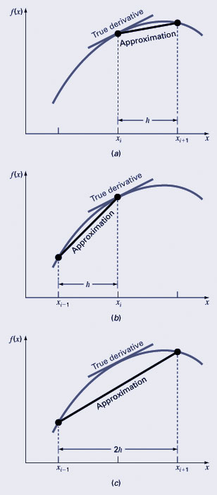
Differentiation - FD
There are also backward difference and centered difference approximations, depending on the points used:
Forward:
Backward:
Centered:

Slide 7


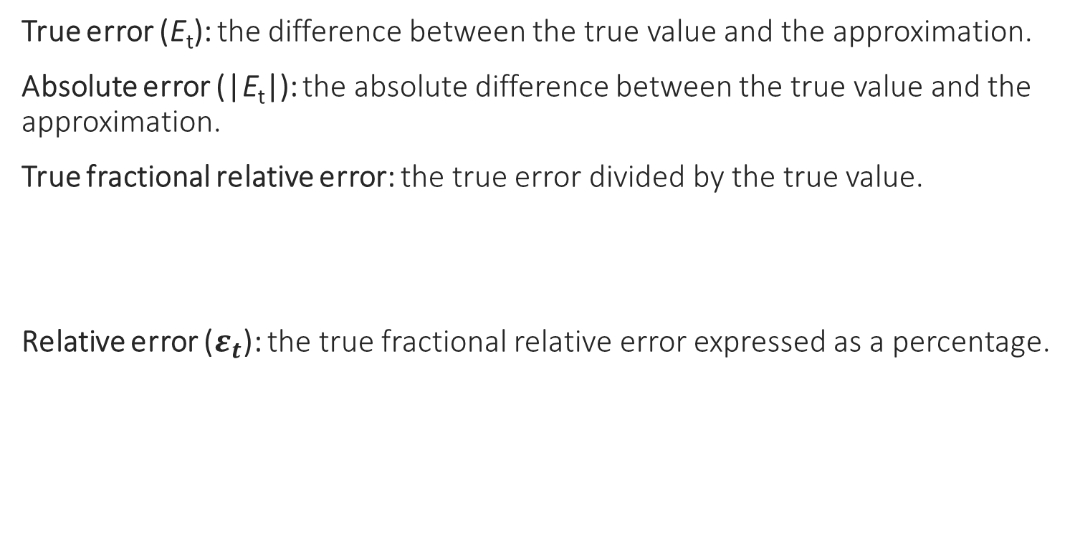
Error Definitions
True error (E_{t}): the difference between the true value and the approximation.
Absolute error (|E_{t}|): the absolute difference between the true value and the approximation.
True fractional relative error: the true error divided by the true value.
Relative error ($ε_{t}$): the true fractional relative error expressed as a percentage.

Slide 8
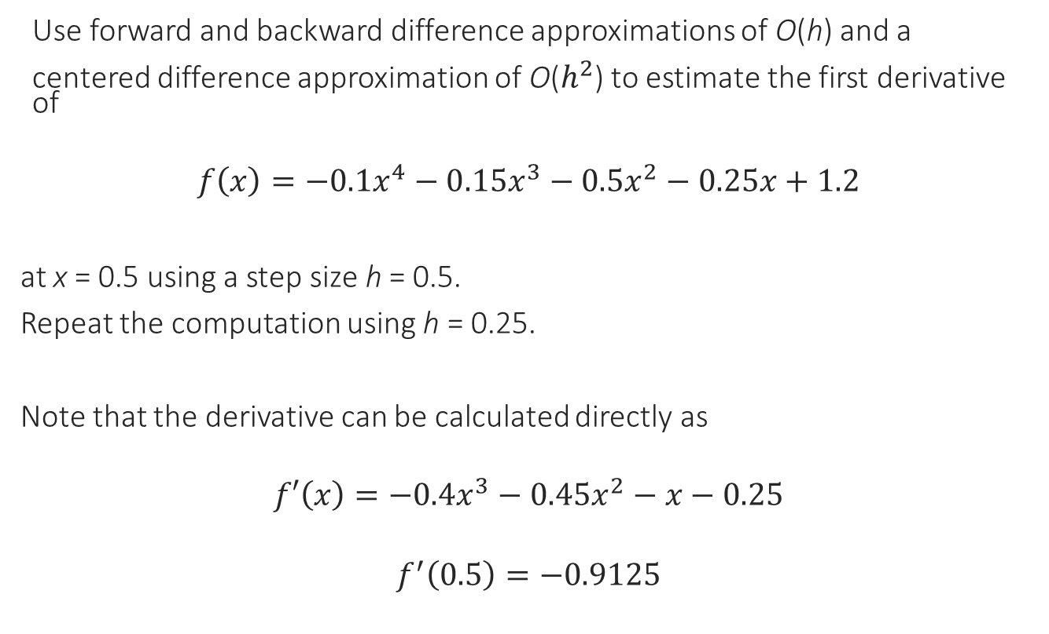
Finite difference error Example
Use forward and backward difference approximations of O(h) and a
centered difference approximation of O($h^{2}$) to estimate the first derivative of
$$f\left(x\right)=−0.1x^{4}−0.15x^{3}−0.5x^{2}−0.25x+1.2$$
at x = 0.5 using a step size h = 0.5.
Repeat the computation using h = 0.25.
Note that the derivative can be calculated directly as
$$f′\left(x\right)=−0.4x^{3}−0.45x^{2}−x−0.25$$
$$f^{′}\left(0.5\right)=−0.9125$$

Slide 9


Finite difference error Example
For h=0.5
Forward:
Backward
Centered

Slide 10
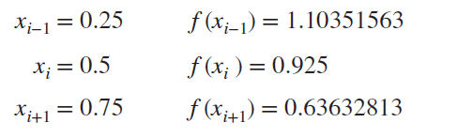



Finite difference error Example
For h=0.25
Forward
Backward
Centered

Slide 11
Finite difference & Taylor series
Second derivative
Use Taylor series to approximate the second derivative of a function f.

Slide 12
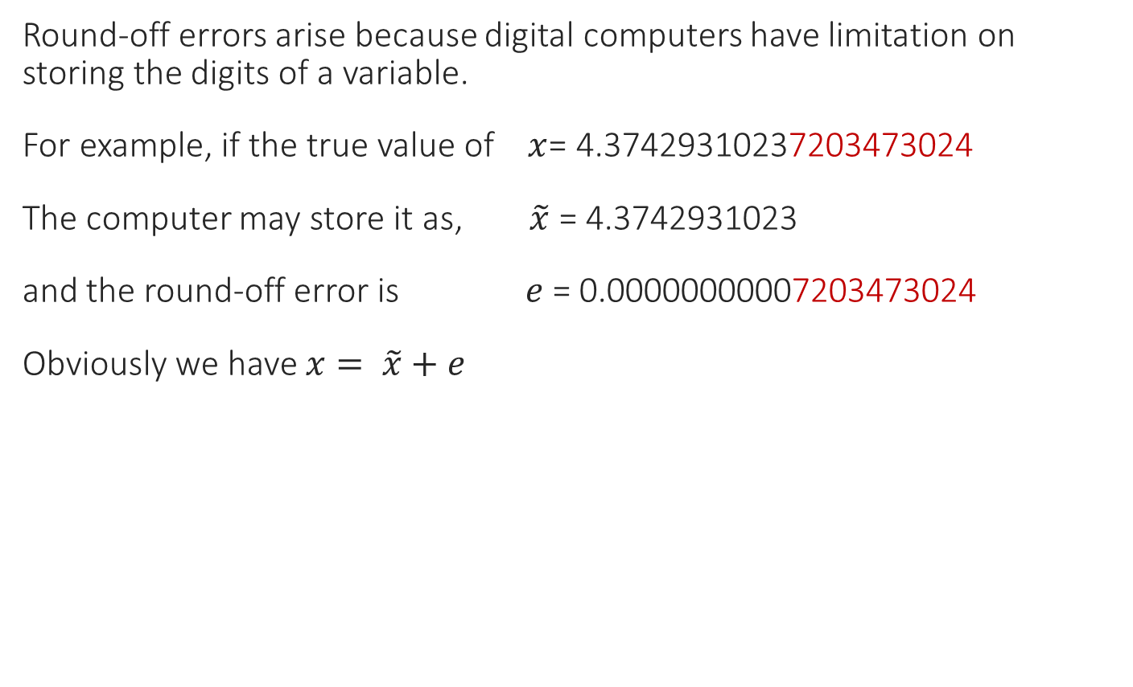
Round-off Errors
Round-off errors arise because digital computers have limitation on storing the digits of a variable.
For example, if the true value of $x$= 4.37429310237203473024
The computer may store it as, $\tilde{x}$ = 4.3742931023
and the round-off error is $e$ = 0.00000000007203473024
Obviously we have $x= \tilde{x}+e$

Slide 13

Round-off errors and truncation errors
Let’s take the example of second-order FD of the first derivative,
$$f^{′}\left(x_{i}\right)=\frac{f\left(x_{i+1}\right)−f\left(x_{i−1}\right)}{2h}−\frac{f′′′}{6}h^{2}$$
And since we have round-off errors the values of the function $f$ are saved in computer as $\tilde{f}$ with a truncation of $e$, and we have,
$$f\left(x_{i+1}\right)= \tilde{f}\left(x_{i+1}\right)+{\tilde{e}}_{i+1}$$
$$f\left(x_{i−1}\right)= \tilde{f}\left(x_{i−1}\right)+{\tilde{e}}_{i−1}$$
Thus,
$$f^{′}\left(x_{i}\right)=\frac{\tilde{f}\left(x_{i+1}\right)−\tilde{f}\left(x_{i−1}\right)}{2h}+ \frac{{\tilde{e}}_{i+1}−{\tilde{e}}_{i−1}}{2h}−\frac{f′′′}{6}h^{2}$$
For a maximum absolute value of $ε$ for $({\tilde{e}}_{i+1}−{\tilde{e}}_{i−1})/2$, and a maximum absolute value of $M$ for $−f′′′$ we have,
$$Total Error=\left|f^{′}\left(x_{i}\right)−\frac{\tilde{f}\left(x_{i+1}\right)−\tilde{f}\left(x_{i−1}\right)}{2h}\right| <\frac{ε}{h}+\frac{Mh^{2}}{6}$$
The optimum value of $h$ is found to be, $h= \sqrt[3]{\frac{3ε}{M}}$

Slide 14
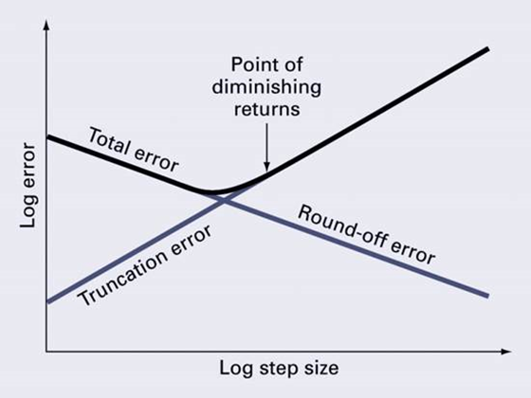
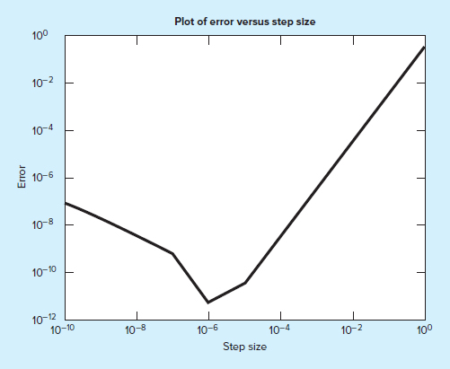

Round-off errors and truncation errors
we used a centered difference approximation to estimate the first derivative of the following function at x = 0.5,
$$f\left(x\right)=−0.1x^{4}−0.15x^{3}−0.5x^{2}−0.25x+1.2$$
Perform the same computation starting with h = 1. Then progressively divide the step size by a factor of 10 to demonstrate how roundoff becomes dominant as the step size is reduced.

